Slide 1
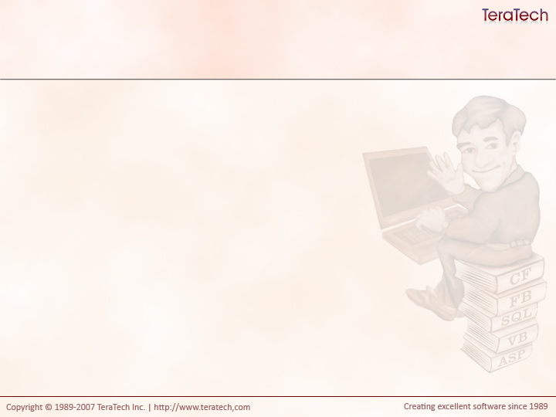
Things You Need To Know
Helpful things to understand before we jump head first into Model-Glue

Slide 2
Tradition Development Techniques
The Page Is King!
Shared scopes for everyone!
Application.cfm sets up shared variables
Explicit Logic – or – I do I have to tell you everything?!
Includes and custom tags for code reuse
Goal Oriented
  To do X we need to first do a, b, and c

Slide 3
The Sad, Sad Procedural World
No control over what’s touching data
  Where did that come from?
Testing is painful, if possible
Commingling of presentation and business logic
  Question: How easy would it be to redesign the PITS application?
Harder to reuse logic
Structure becomes brittle
  Changes in one place unexpectedly break code in other places.
Notes:
Point out the difficulty of some of the changes in the first coding project. EG: changing the datasource name.

Slide 4
Design Patterns To the Rescue!
Provide time tested solutions to common problems
Model-Glue prominently uses two patterns:
  Model View Controller (MVC)
  Implicit Invocation (II)
Notes:
Discus Common techniques they use to solve common problems at Carfax

Slide 5
Model-View Controller
M = Model = CFC
  Only does stuff
V = View = CFM
  Only shows stuff
C = Controller = CFC
  Has the model do stuff
  passes stuff to view to show

Slide 6
Exercise Time!
For my first trick I’ll need three volunteers
Notes:
Exercise: Get three people. One for the Model, one for Controller, one for View. Don’t tell anyone the purpose of the application.
- Give the Model a list of phrases and their translation into another language. Tell them that for a language and string write the translation on a note card and return it.
- Tell the Controller to pass all input to the model and to hand what the controller returns to the view.
- Tell the view to write what the controller gives it on the whiteboard.
Use note cards to pass the values along
Ask view what the purpose of the application was.
Ask the controller what the purpose of the application was.
Ask the model.
Repeat example a few times.
Explain the process we went through.
Ask the view to change how the output looks and rerun.
Ask the model how that changed its behavior.
Ask the model to return pig Latin.
Ask the view how it changed its behavior.

Slide 7
Benefits of MVC
Business objects only know what the need to
Logic can be reused without impact
  Can change the translator
Views don’t care where data comes from

Slide 8
Tradeoffs of MVC
More code
Initially feels unnecessarily complex
More hoops to jump through
Controllers are not terribly reusable
  They are tied to data input

Slide 9
Controllers are NOT the Model
It’s easy to put logic in the controller
If you put your logic in your controller how can you reuse that logic?

Slide 10
Implicit Invocation
One action implies others
For example: If I ask for a list of people, the fact that the list is retried is implicit.
I don’t care how the list was retrieved
  Databae
  Text file
  XML
  LDAP
Notes:
Discuss: What do you do when a baby cries?
Feed it!
Why?
Their need is implicit in their cry. They’re implicitly invoking your feeding routine.
A baby’s cry might have more than one meaning. The cry can imply a lot of different things.
Dirty
Tired
Grumpy
Dropped Toy
My Teeth Hurt
Why do parents do? They take care of everything!

Slide 11
MVC and II Together
“Decouples” your presentation from your business logic
Helps your application become more resilient to change.
Your display code doesn’t care about how to query for data, just that it gets the data
Your display code doesn’t care what the API of your CFCs are, just that it gets the data.
Your model doesn’t care how data is displayed.
This is called “Separation of Concerns”.

Slide 12
Separation of Concerns
Presentation and Business Logic are separate.
  They don’t care (or know) about each other.
This pattern should be continued throughout the system.
  The translator shouldn’t be validating data, a validator component can do that instead.
  The translator shouldn’t be concerned with security, a security component can do that.
  Does the CEO of a company perform every task?
  Does the CEO of Carfax sit down and code? No. He’s not concerned with it.
  Do developers make business decisions? No, they’re not concerned with it.
Component should do ONE THING and ONE THING well

Slide 13
Questions and Answers

